Slide 1
LAN Protocol Architecture
Corresponds to lower two layers of OSI model
But mostly LANs do not follow OSI model
Current LANs are most likely to be based on Ethernet protocols developed by IEEE 802 committee
IEEE 802 reference model
Logical link control (LLC)
Media access control (MAC)
Physical

Slide 2
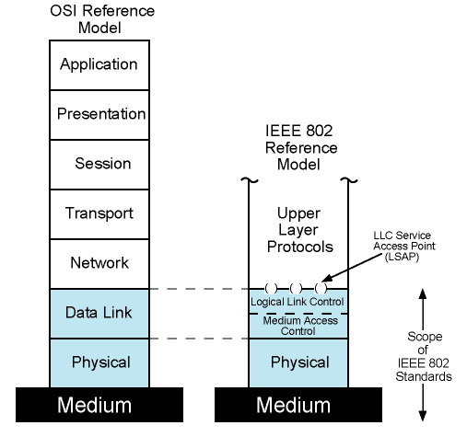
IEEE 802 Protocol Layers vs. OSI Model

Slide 3
IEEE 802 Layers - Physical
Signal encoding/decoding
Preamble generation/removal
for synchronization
Bit transmission/reception
Specification for topology and transmission medium

Slide 4
802 Layers - Medium Access Control & Logical Link Control
OSI layer 2 (Data Link) is divided into two in IEEE 802
Logical Link Control (LLC) layer
Medium Access Control (MAC) layer
LLC layer
Interface to higher levels
flow control
Based on classical Data Link Control Protocols
MAC layer
Prepare data for transmission
Error detection
Address recognition
Govern access to transmission medium
Not found in traditional layer 2 data link control

Slide 5
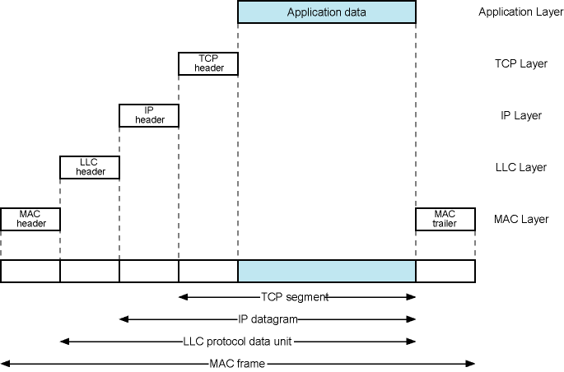
LAN Protocols in Context

Slide 6
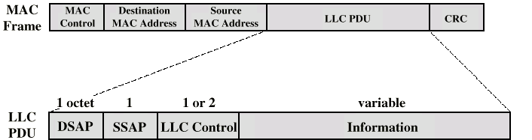
Generic MAC & LLC Format
Actual format differs from protocol to protocol
MAC layer receives data from LLC layer
MAC layer detects errors and discards frames
LLC optionally retransmits unsuccessful frames

Slide 7
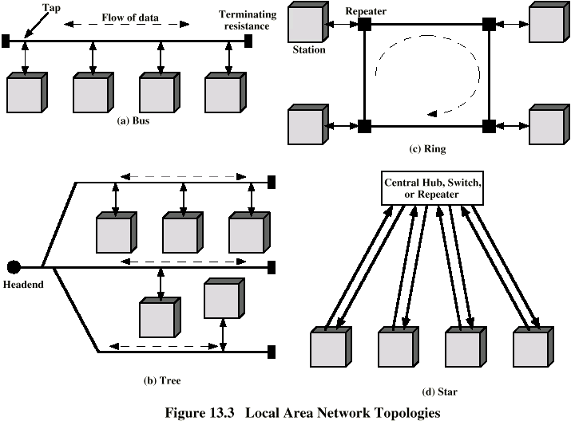
LAN Topologies
Bus
Ring
Star

Slide 8
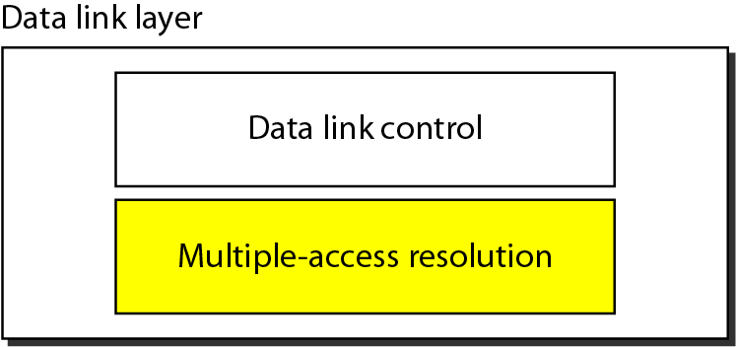
Data link layer divided into two functionality-oriented sublayers
Responsible for error and flow control
Responsible framing and MAC address and Multiple Access Control

Slide 9
Medium Access Control
In most networks, multiple nodes share a communication medium for transmitting their data packets
The Medium Access Control (MAC) protocol is primarily responsible for regulating access to the shared medium

Slide 10
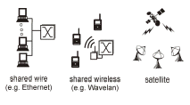
Multiple Access
Broadcast link used in LAN consists of multiple sending and receiving nodes connected to or use a single shared link
Broadcast links Examples

Slide 11
Multiple Access
Problem: When two or more nodes transmit at the same time, their frames will collide and the link bandwidth is wasted during collision
How to coordinate the access of multiple sending/receiving nodes to the shared link???
Solution: We need a protocol to coordinate the transmission of the active nodes
These protocols are called Medium or Multiple Access Control (MAC) Protocols belong to a sublayer of the data link layer called MAC (Medium Access Control)

Slide 12
Main task is to minimize collisions in order to utilize the bandwidth by:
Determining when a station can use the link (medium)
what a station should do when the link is busy
what the station should do when it is involved in collision

Slide 13
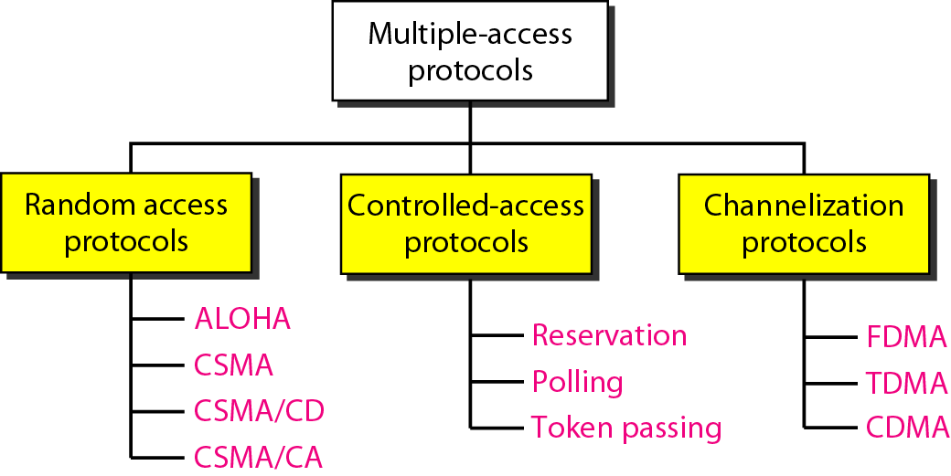
Taxonomy of multiple-access protocols

Slide 14
Random Access
Random Access (or contention) Protocols:
No station is superior to another station and none is assigned the control over another.
A station with a frame to be transmitted can use the link directly based on a procedure defined by the protocol to make a decision on whether or not to send.
Original ALOHA technique used a ground based radio packet system rather than satellites.
ALOHA Protocols was designed for wireless LAN and can be used for any shared medium

Slide 15
Pure ALOHA Protocol
All frames from any station are of fixed length (L bits)
Stations transmit at equal transmission time (all stations produce frames with equal frame lengths).
A station that has data can transmit at any time
After transmitting a frame, the sender waits for an acknowledgment for an amount of time (time out) equal to the maximum round-trip propagation delay = 2* t_{prop}
If no ACK was received, sender assumes that the frame or ACK has been destroyed and resends that frame after it waits for a random amount of time
If station fails to receive an ACK after repeated transmissions, it gives up

Slide 16
Channel utilization or efficiency or Throughput is the percentage of the transmitted frames that arrive successfully (without collisions) or the percentage of the channel bandwidth that will be used for transmitting frames without collisions
ALOHA Maximum channel utilization is 18% (i.e, if the system produces F frames/s, then 0.18 * F frames will arrive successfully on average without the need of retransmission).

Slide 17
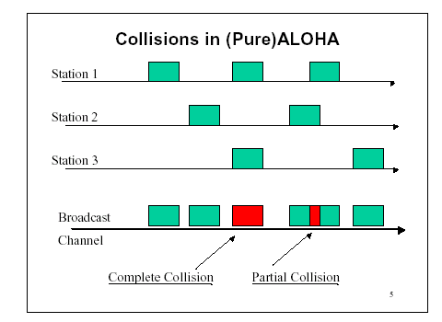
Pure ALOHA
In pure ALOHA, frames are transmitted at completely arbitrary times.

Slide 18

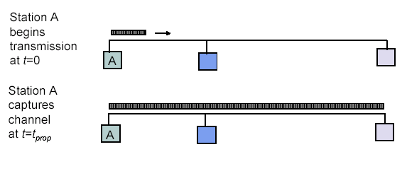
Maximum Propagation Delay
Maximum propagation delay(t_{prop}): time it takes for a bit of a frame to travel between the two most widely separated stations.
The farthest station
Station B receives the first bit of the frame at time t= t_{prop}

Slide 19
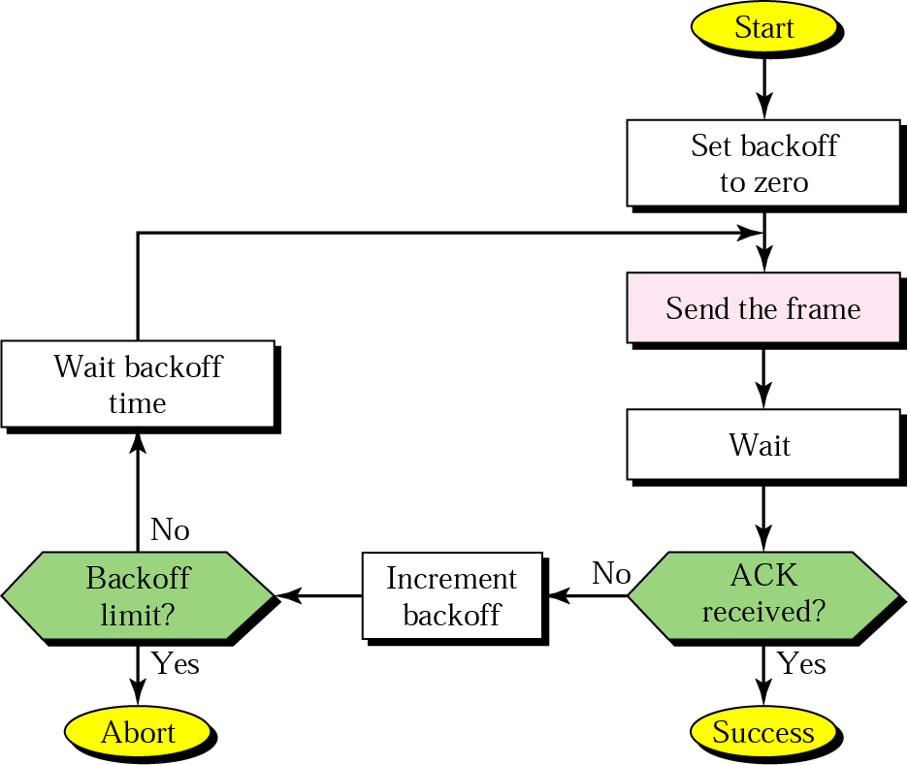
Procedure for ALOHA protocol

Slide 20
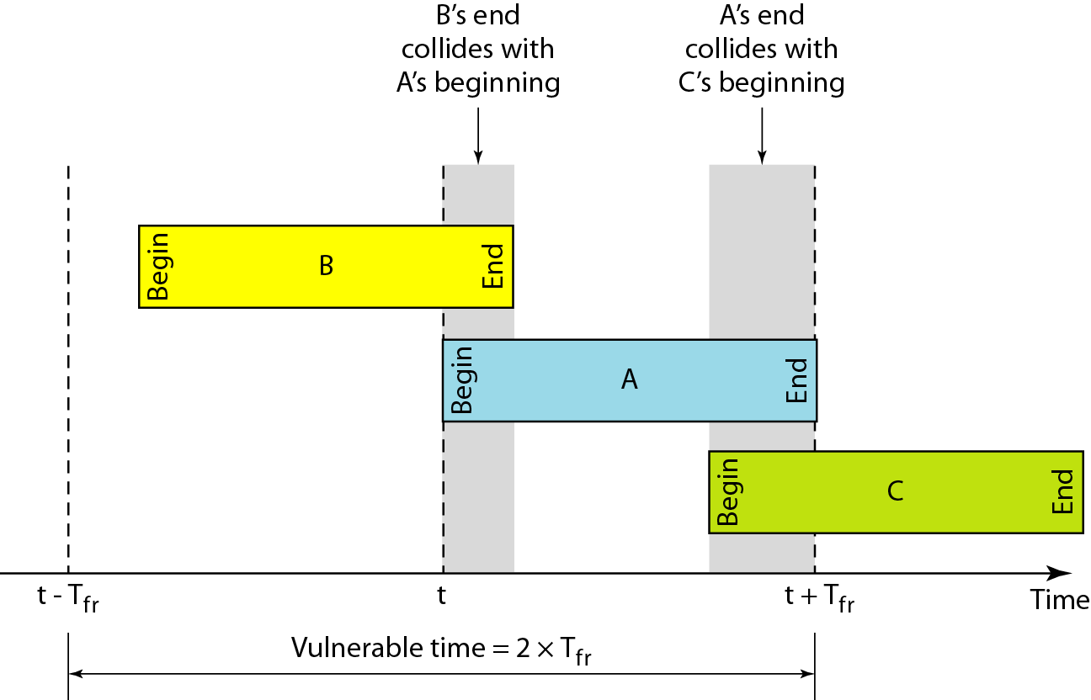
Critical time for pure ALOHA protocol

Slide 21
If the frame transmission time is T sec, then the vulnerable time is = 2 T sec.
This means no station should send during the T-sec before this station starts transmission and no station should start sending during the T-sec period that the current station is sending.

Slide 22
The throughput ( S) for pure ALOHA is
S = G × e ^{−2G} .
The maximum throughput
S_{max} = 0.184 when G= (1/2).
where G is the average number of frames generated by the system (all stations) during one frame transmission time

Slide 23
Random Access – Slotted ALOHA
Time is divided into slots equal to a frame transmission time (T_{fr})
A station can transmit at the beginning of a slot only
If a station misses the beginning of a slot, it has to wait until the beginning of the next time slot.
A central clock or station informs all stations about the start of a each slot
Maximum channel utilization is 37%

Slide 24
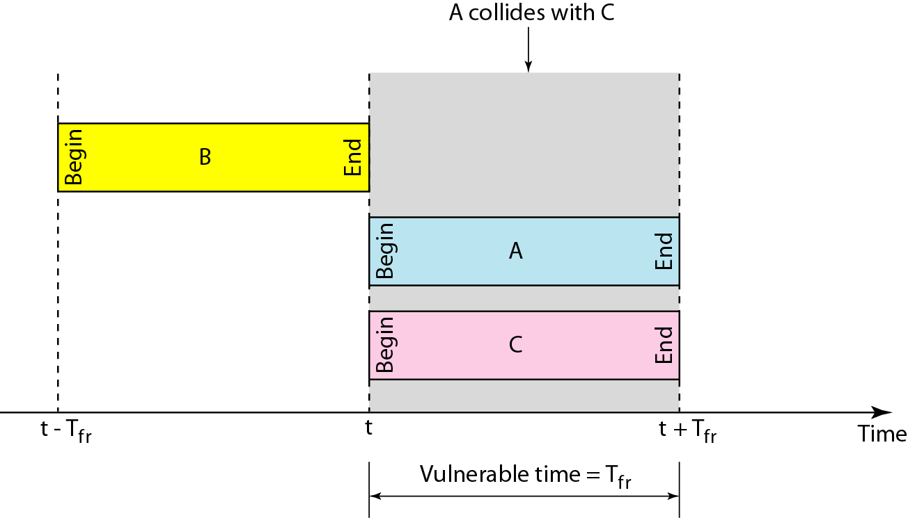
In danger time for slotted ALOHA protocol

Slide 25
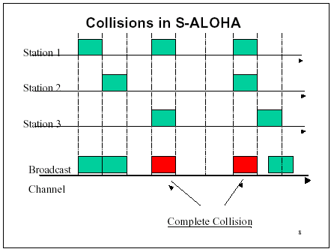
Random Access – Slotted ALOHA

Slide 26
The throughput for slotted ALOHA is S = G × e^{−G} .
The maximum throughput S_{max} = 0.368 when G = 1.

Slide 27
Efficiency of Aloha
0.4
0.3
S = throughput =(success rate)
Slotted Aloha
0.2
0.1
Pure Aloha
0.5
1.0
1.5
2.0
G = offered load rate= new frames+ retransmitted
= Total frames presented to the link per
the transmission time of a single frame

Slide 28
Reservation ALOHA
Basic TDM model and adapts to slotted ALOHA for low channel utilization
N consecutive slots are grouped together into a group, each station owning one slot
If number of stations is less than the slots, then the extra slots are not assigned to stations
The owner of the slot does nothing when there is nothing to transmit
In this case, during the next round the other stations use the slot.

Slide 29
Advantages of ALOHA protocols
A node that has frames to be transmitted can transmit continuously at the full rate of channel (R bps) if it is the only node with frames
Simple to be implemented
No master station is needed to control the medium
Disadvantages
If (M) nodes want to transmit, many collisions can occur and the rate allocated for each node will not be on average R/M bps
This causes low channel utilization

Slide 30
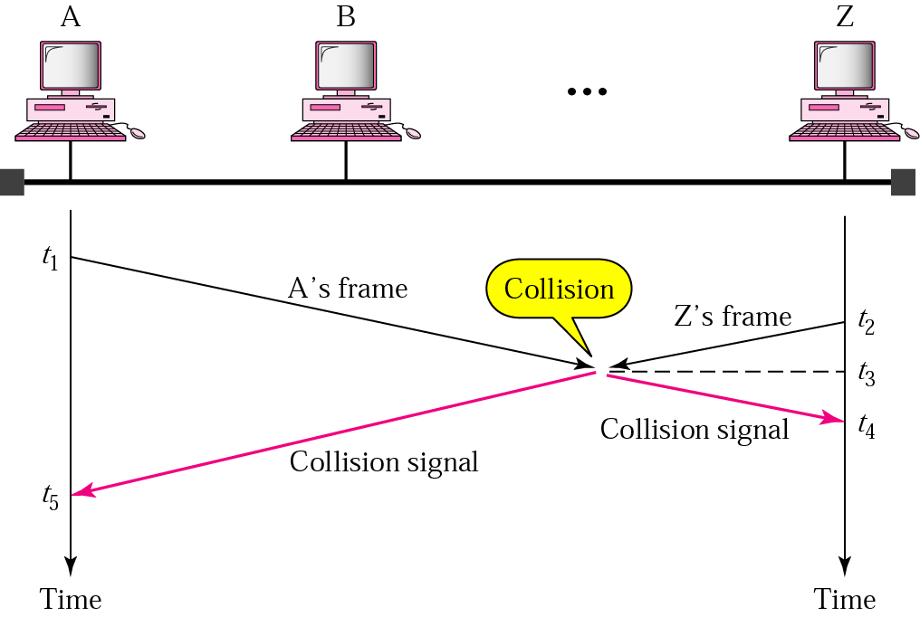
Random Access – Carrier Sense Multiple Access (CSMA)
To improve performance, avoid transmissions that are certain to cause collisions
Based on the fact that in LAN propagation time is very small
➔ If a frame was sent by a station, All stations knows immediately so they can wait before start sending
➔ A station with frames to be sent, should sense the medium for the presence of another transmission (carrier) before it starts its own transmission (Listen Before Talk)
This can reduce the possibility of collision but it cannot eliminate it.
Collision can only happen when more than one station begin transmitting within a short time (the propagation time period)

Slide 31
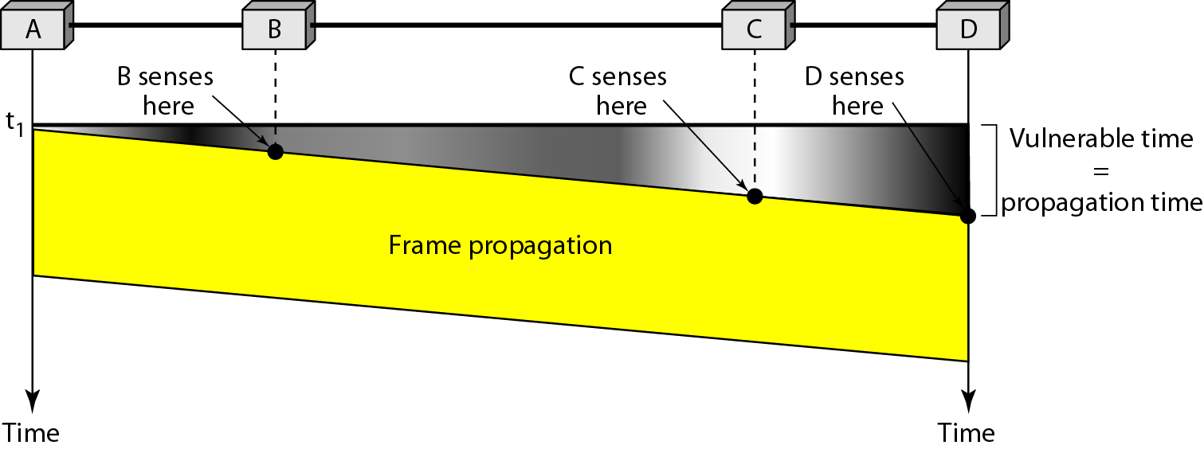
Random Access – Carrier Sense Multiple Access (CSMA)
Vulnerable time for CSMA is the maximum propagation time
The longer the propagation delay, the worse the performance of the protocol because of the above case.

Slide 32
Types of CSMA Protocols
Different CSMA protocols that determine:
What a station should do when the medium is idle?
What a station should do when the medium is busy?
Non-Persistent CSMA
1-Persistent CSMA
p-Persistent CSMA

Slide 33
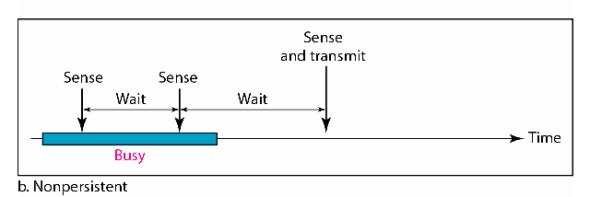
Nonpersistent CSMA
A station with frames to be sent, should sense the medium
If medium is idle, transmit; otherwise, go to 2
If medium is busy, (backoff) wait a random amount of time and repeat 1
Non-persistent Stations are deferential (respect others)
Performance:
Random delays reduces probability of collisions because two stations with data to be transmitted will wait for different amount of times.
Bandwidth is wasted if waiting time (backoff) is large because medium will remain idle following end of transmission even if one or more stations have frames to send
Random Waiting times
Wasted time

Slide 34
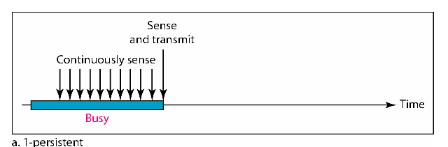
1-persistent CSMA
To avoid idle channel time, 1-persistent protocol used
Station wishing to transmit listens to the medium:
If medium idle, transmit immediately;
If medium busy, continuously listen until medium becomes idle; then transmit immediately with probability 1
Performance
1-persistent stations are selfish
If two or more stations becomes ready at the same time, collision guaranteed

Slide 35
p-Persistent CSMA
Applies to slotted channels- Time is divided to slots where each Time unit (slot) typically equals maximum propagation delay
Station wishing to transmit listens to the medium:
If channel is busy, then check the next slot
If channel is idle
send with a probability p
defer until the next slot with probability 1 – p
repeat this algorithm until it sends or channel becomes busy by another station
if channel becomes busy in one of these slots, wait until channel is available and repeat the same algorithm
if collision occurs, then wait a random period of time and repeat the same algorithm
larger p means smaller channel utilization and smaller waiting time for the packets

Slide 36
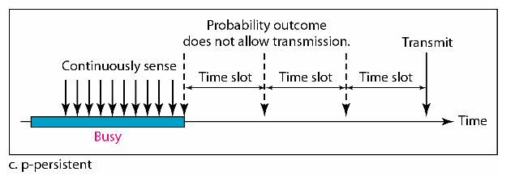
P-persistent CSMA

Slide 37
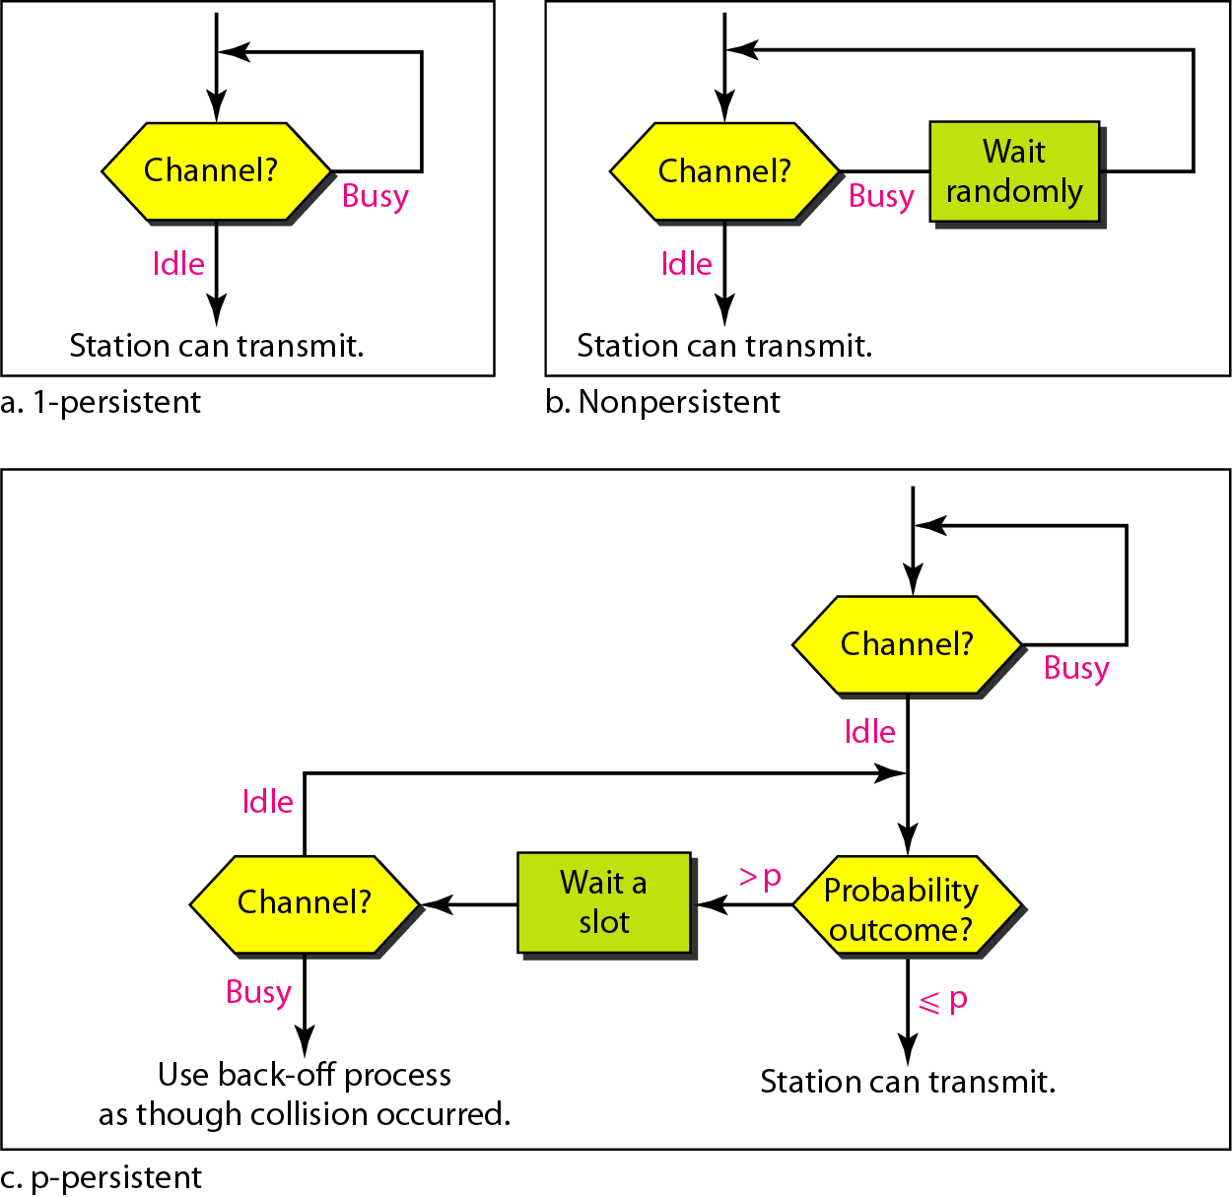
Flow diagram for three persistence methods

Slide 38
All CSMA Persistence schemes altogether

Slide 39
CSMA/CD (Collision Detection)
CSMA (all previous methods) has an inefficiency:
If a collision has occurred, the channel is unstable until colliding packets have been fully transmitted
CSMA/CD (Carrier Sense Multiple Access with Collision Detection) overcomes this as follows:
While transmitting, the sender is listening to medium for collisions. (Listen While Talk)
Sender stops transmission if collision has occurred reducing channel wastage .
CSMA/CD is Widely used for bus topology LANs (IEEE 802.3, Ethernet).

Slide 40
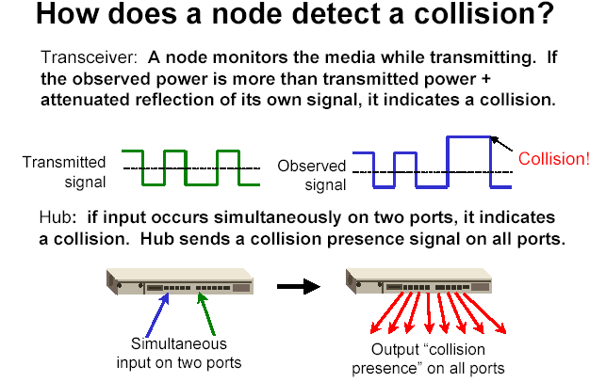

Slide 41
CSMA/CD Protocol
Use one of the CSMA persistence algorithm (non-persistent, 1-persistent, p-persistent) for transmission
If a collision is detected by a station during its transmission then it should do the following:
Abort transmission and
Transmit a jam signal (48 bit) to notify other stations of collision so that they will discard the transmitted frame also to make sure that the collision signal will stay until detected by the furthest station
After sending the jam signal, backoff (wait) for a random amount of time, then
Transmit the frame again

Slide 42
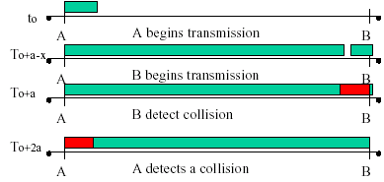
CSMA/CD
Question: How long does it take to detect a collision?
Answer: In the worst case, twice the maximum propagation delay of the medium
Note: a = maximum propagation delay

Slide 43
CSMA/CD
Restrictions of CSMA / CD:
Packet transmission time should be at least as long as the time needed to detect a collision (2 * maximum propagation delay + jam sequence transmission time)
Otherwise, CSMA/CD does not have an advantage over CSMA

Slide 44
Exponential Backoff Algorithm
Ethernet uses the exponential backoff algorithms to determine the best duration of the random waiting period after the collision happens
Algorithm:
Set “slot time” equal to 2*maximum propagation delay + Jam sequence transmission time (= 51.2 µsec for Ethernet 10-Mbps LAN)
After K^{th} collision, select a random number (R) between 0 and 2^{k} –1 and wait for a period equal to (R*slot time) then retransmit when the medium is idle, for example:
After first collision (K=1), select a number (R) between 0 and 2¹ –1 {0 ,1} and wait for a period equal to R*slot times (Wait for a period 0 µsec or 1x51.2 µsec) then retransmit when the medium is idle
Do not increase random number range, if K=10
➔ Maximum interval {0 – 1023}
Give up after 16 unsuccessful attempts and report failure to higher layers

Slide 45
Exponential Backoff Algorithm
Reduces the chance of two waiting stations picking the same random waiting time
When network traffic is light, it results in minimum waiting time before transmission
As congestion increases ( traffic is high), collisions increase, stations backoff by larger amounts to reduce the probability of collision.
Exponential Back off algorithm gives last-in, first-out effect
Stations with no or few collisions will have the chance to transmit before stations that have waited longer because of their previous unsuccessful transmission attempts.

Slide 46
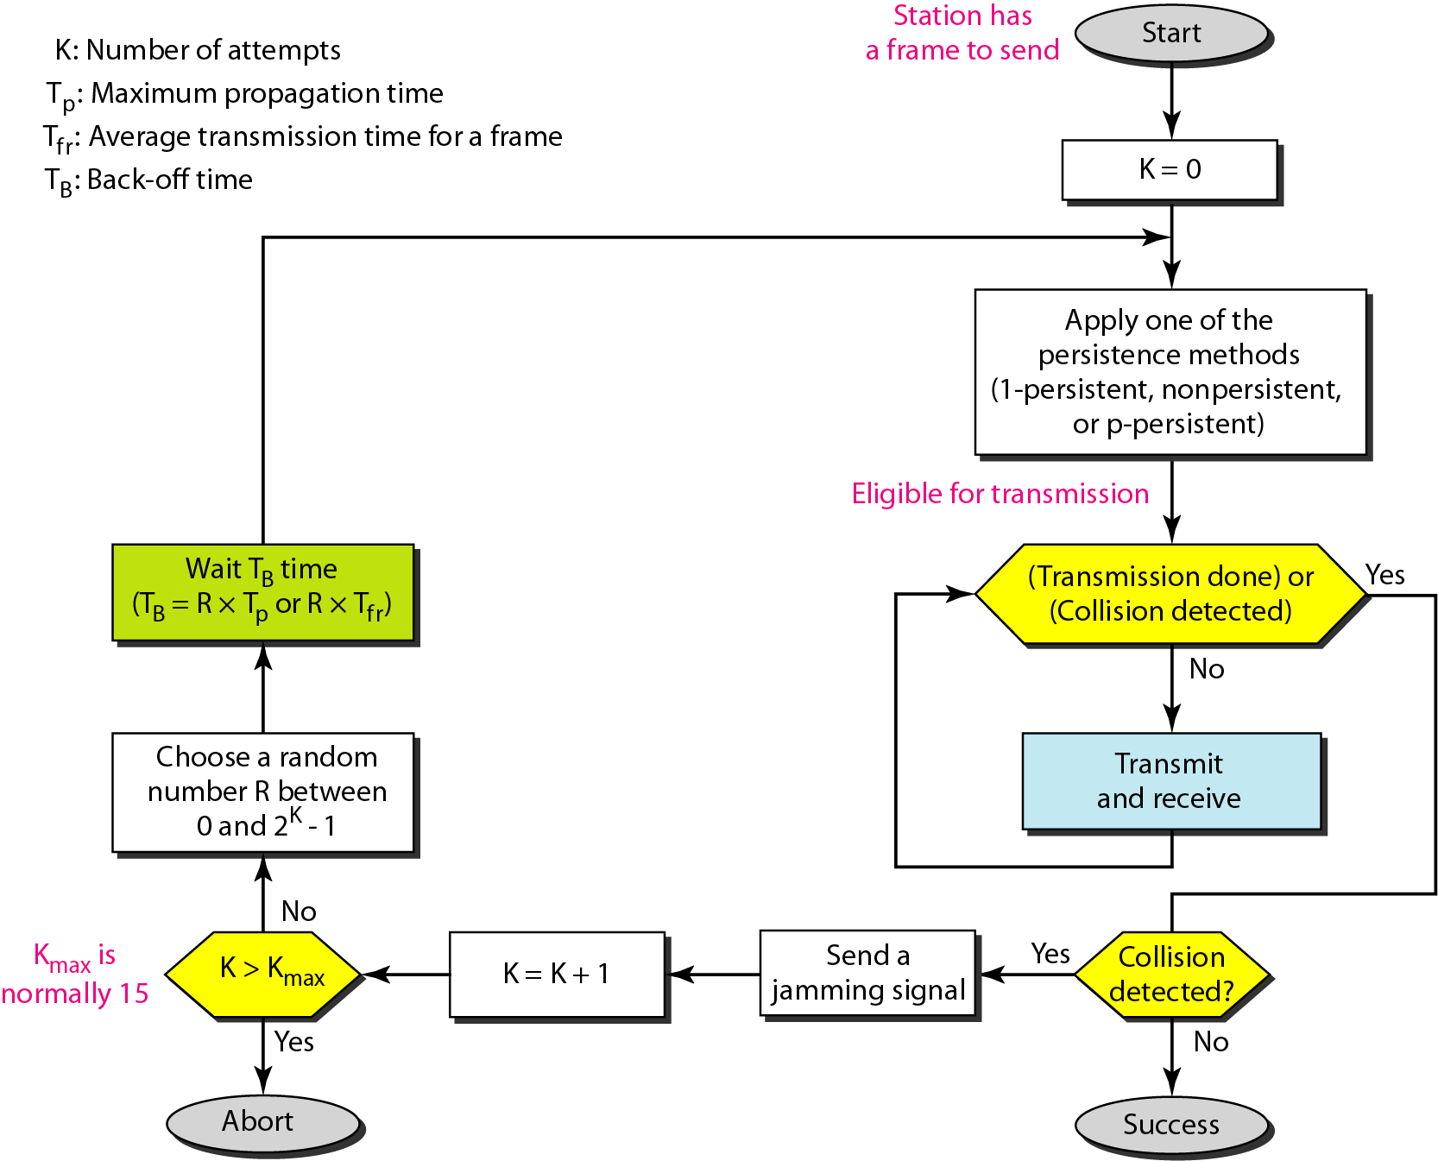
Flow diagram for the CSMA/CD
N=0
Wait R*slot time
Choose R between 0 & 2^{k} - 1
K=10
K=N
No
Yes
No
N < 10
N==16
N=N+1
Yes
Abort

Slide 47
CSMA/CD: carrier sensing, deferral as in CSMA
collisions detected within short time
colliding transmissions aborted, reducing channel wastage
collision detection:
easy in wired LANs: measure signal strengths, compare transmitted, received signals
difficult in wireless LANs: receiver shut off while transmitting

Slide 48
Wireless Network
The difference between wired and wireless is the physical layer and the data link layer
Physical Layer
Wired network technology is based on wires or fibers
Data transmission in wireless networks take place using electromagnetic waves which propagates through space (scattered, reflected, attenuated)
Data are modulated onto carrier frequencies (amplitude, frequency)
The data link layer (accessing the medium, multiplexing, error correction, synchronization) requires more complex mechanisms.

Slide 49
Reference Model

Slide 50
IEEE 802.11 standard for WLAN defines a distributed coordination function (DCF) for sharing access to the medium based on the CSMA/CA protocol
Collision detection is not used since a node is unable to detect the channel and transmit data simultaneously
A node listens to the channel before transmission to determine whether some one else is transmitting
The receiving node sends an acknowledge packet (ACK) a short time interval after receiving the packet
If an ACK is not received, the packet is considered lost and a retransmission is arranged

Slide 51
In 802.11 wireless LANs, “seizing channel” does not exist as in 802.3 wired Ethernet.
Two additional problems:
Hidden Terminal Problem
Exposed Station Problem

Slide 52
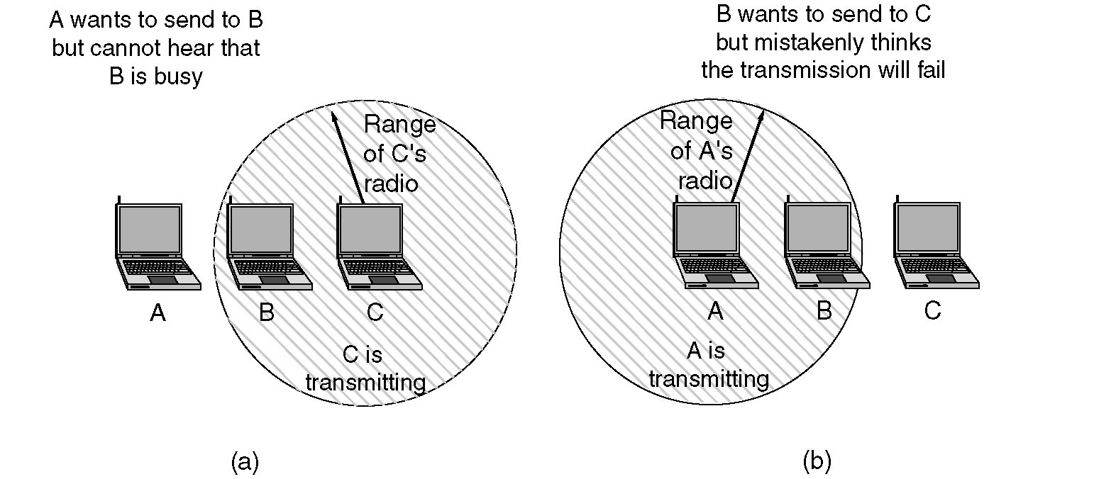
Figure 4-26.(a)The hidden station problem. (b) The exposed station problem.

Slide 53
The Hidden Terminal Problem
Wireless stations have transmission ranges and not all stations are within radio range of each other.
Simple CSMA will not work!
C transmits to B.
If A “senses” the channel, it will not hear C’s transmission and falsely conclude that A can begin a transmission to B.

Slide 54
The Exposed Station Problem
This is the inverse problem.
B wants to send to C and listens to the channel.
When B hears A’s transmission, B falsely assumes that it cannot send to C.

Slide 55
Distributed Coordination Function (DCF) basic access
DCF consists of a basic access mode as well as an optional Request to send / Clear to send (RTS/CTS) access mode
In basic access mode the node senses the channel to determine whether another node is transmitting before initiating a transmission
If the medium is sensed to be free for a DCF inter-frame space (DIFS) time interval the transmission will proceed
If the medium is busy the node defers its transmission until the end of the current transmission and then it will wait an additional DIFS interval and generate a random backoff delay uniformly chosen in the range [0,W − 1] where W is called the backoff window or contention window (CW)

Slide 56
The backoff timer is decreased as long as the medium is sensed to be idle for a DIFS, and frozen when a transmission is detected on the medium, and resumed when the channel is detected as idle again for a DIFS interval
When the backoff reaches 0, the station transmits its packet
For IEEE 802.11 time is slotted in a basic time unit which is the time needed to detect the transmission of a packet from any other station
The initial CW is set to W = 1, if two or more nodes decrease their backoff timer to 0 at the same time a collision occur, at this situation the CW is doubled for each retransmission until it reaches a maximum value

Slide 57
A short inter-frame space (SIFS) is used to give priority access to ACK packets
When receiving a packet correctly, the destination node waits for a SIFS interval immediately after the reception has completed and transmits an ACK back to the source node confirming the correct reception
If the source node does not receive an ACK due to collision or transmission errors it reactivates the backoff algorithm after the channel remains idle for an extended IFS (EIFS) interval

Slide 58
CSMA/CA
Node A’s frame
Node B’s frame
Node C’s frame
Delay: B
Delay: C
Time
Nodes B & C sense the medium
Nodes C starts transmitting.
Nodes B resenses the medium and transmits its frame.
Node C freezes its counter.
Nodes C resenses the medium and starts decrementing its counter.

Slide 59
CSMA/CA
DIFS
DIFS
Contention window
Contention
window
Medium Busy
Next Frame
Time
Defer access
Slot
Backoff after defer
DIFS – Distributed Inter Frame Spacing

Slide 60
CSMA/CA/ACK
DIFS
Time
Data
Source
SIFS
ACK
Destination
DIFS
Contention window
Next Frame
Other
Defer access
Backoff after defer
SIFS – Short Inter Frame Spacing

Slide 61
Performance of Random Access Protocols
Simple and easy to implement
Decentralized (no central device that can fail and bring down the entire system)
In low-traffic, packet transfer has low-delay
However, limited throughput and in heavier traffic, packet delay has no limit.
In some cases, a station may never have a chance to transfer its packet. (unfair protocol)
A node that has frames to be transmitted can transmit continuously at the full rate of channel (R) if it is the only node with frames
If (M) nodes want to transmit, many collisions can occur and the rate for each node will not be on average R/M

Slide 62
IEEE 802

Slide 63
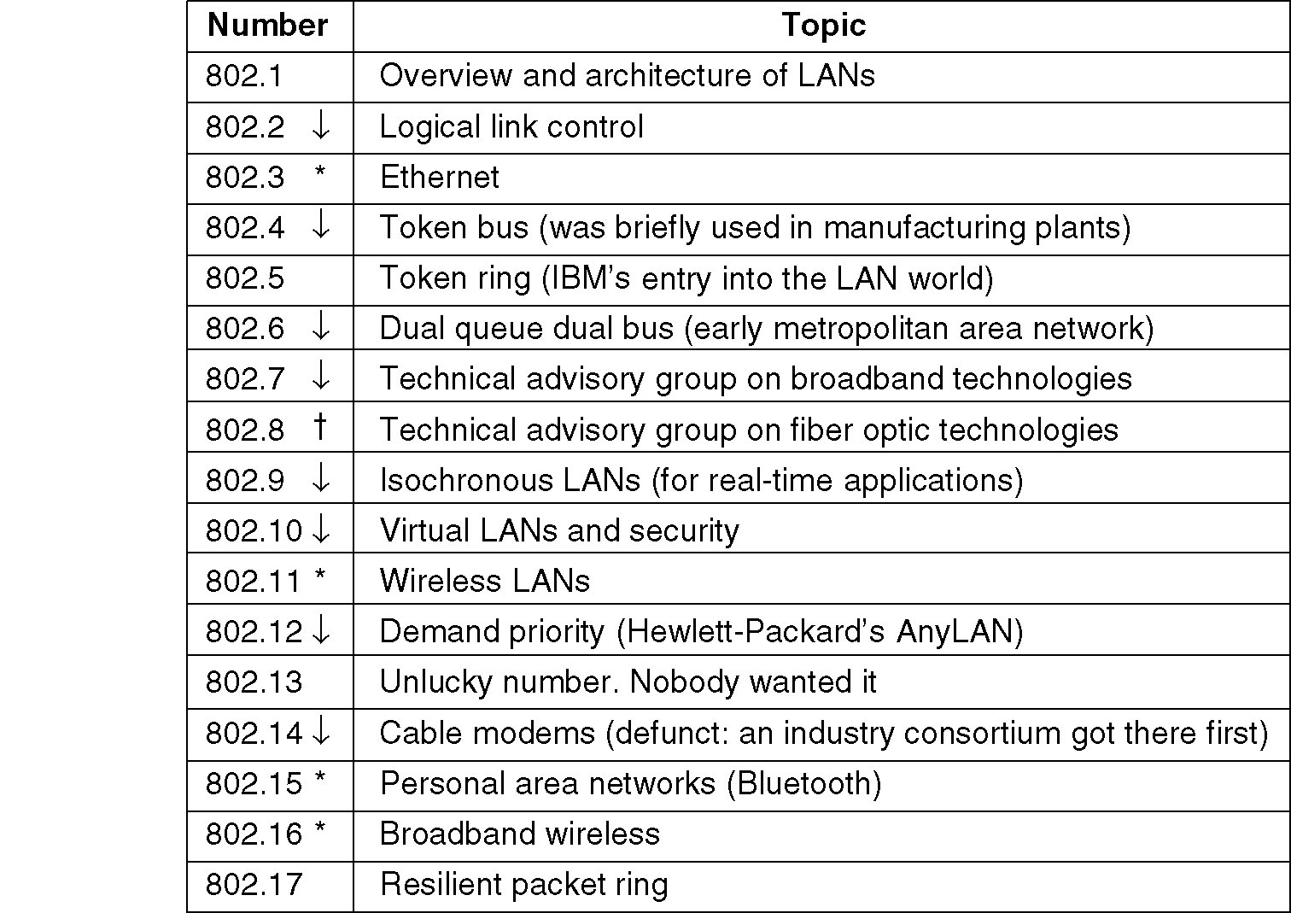
IEEE 802 Standards Working Groups
The important ones are marked with *. The ones marked with ↓ are hibernating. The one marked with † gave up.

Slide 64
CSMA/CD (IEEE 802.3 – Ethernet)
As in 1-persistent CSMA, but uses slotted channels
If medium idle, transmit
If busy, listen for idle slot, then transmit
In regular CSMA, collision occupies medium for duration of transmission
it is inefficient to complete the transmission of a collided packet
In CSMA/CD, stations listen while transmitting
If collision detected (due to high voltage on bus), cease transmission and wait random time then start again
random waiting time is determined using binary exponential backoff mechanism

Slide 65
CSMA/CD - Details of Contention
No acknowledgments in CSMA/CD, so sending station must make sure that:
all other stations are aware of its transmission and
there is no collision on the channel
so the sending station has to continue transmission for a duration of the worst case scenario in which understanding a collision takes as long as the round trip time
this is closely related to the length of the cable (bus) and the propagation speed
for 2500 meters of coax cable (standard for 10 Mbps Ethernet), round trip time is approx 50 microseconds

Slide 66
Minimum Frame Size
at 10 Mbps: one bit takes 100 ns to be transmitted
In order to occupy the channel during 50 microsecs
one frame at minimum should be 500 bits
plus some safety margins and rounding, minimum frame size is set to 512 bits (64 bytes) in IEEE 802.3
Maximum frame size is 1518 bytes
In TCP/IP world the encapsulation of IP datagrams is defined in RFC 894 for Ethernets and in RFC 1042 for IEEE 802 networks

Slide 67
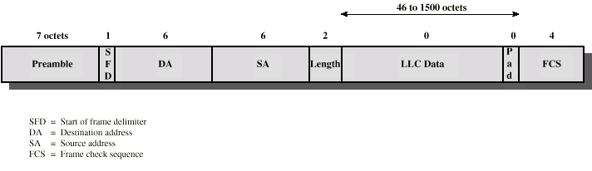
IEEE 802.3 Frame Format
>=
>=
Preamble is alternating 1’s and 0’s (for clock synchronization)
SFD is 10101011
Length is of the LLC data
FCS is 32-bit CRC (Cyclic Redundancy Check) code and excludes Preamble and SFD
Addresses are uniquely assigned by IEEE to manufacturers.

Slide 68
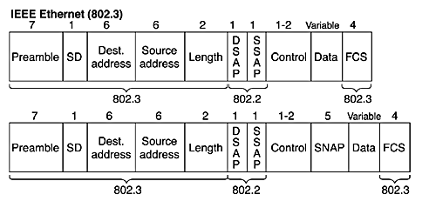
Preamble
SD: Start of frame Delimiter
Destination MAC address
Unicast
Broadcast
Multicast
Source address
Length – total number of bytes following
excluding CRC at the end
DSAP SSAP,
Control
SNAP (Subnet Network Access Protocol)
Data
Frame Check Sequence (FCS)

Slide 69
Controlled Access or Scheduling
Provides in order access to shared medium so that every station has chance to transfer (fair protocol)
Eliminates collision completely
Three methods for controlled access:
Reservation
Polling
Token Passing

Slide 70
Reservation access method
Stations take turns transmitting a single frame at a full rate ( R ) bps
Transmissions are organized into variable length cycles
Each cycle begins with a reservation interval that consists of (N) minislots. One minislot for each of the N stations
When a station needs to send a data frame, it makes a reservation in its own minislot.
By listening to the reservation interval, every station knows which stations will transfer frames, and in which order.
The stations that made reservations can send their data frames after the reservation frame.

Slide 71
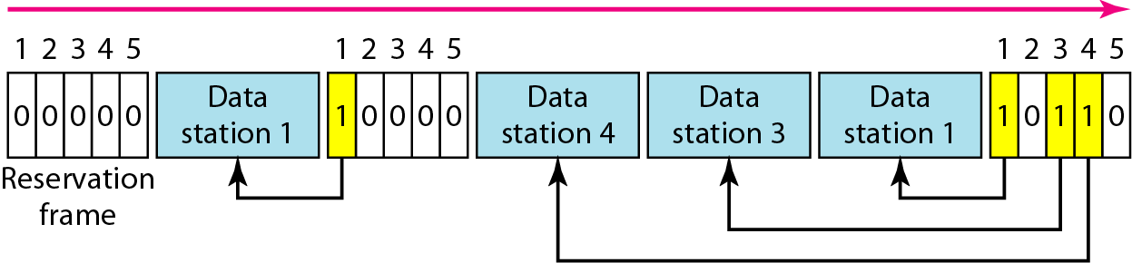

Slide 72
Polling
Stations take turns accessing the medium
Two models: Centralized and distributed polling
Centralized polling
One device is assigned as primary station and the others as secondary stations
All data exchanges are done through the primary
When the primary has a frame to send it sends a select frame that includes the address of the intended secondary
When the primary is ready to receive data it send a Poll frame for each device to ask if it has data to send or not. If yes, data will be transmitted otherwise NAK is sent.
Polling can be done in order (Round-Robin) or based on predetermined order

Slide 73
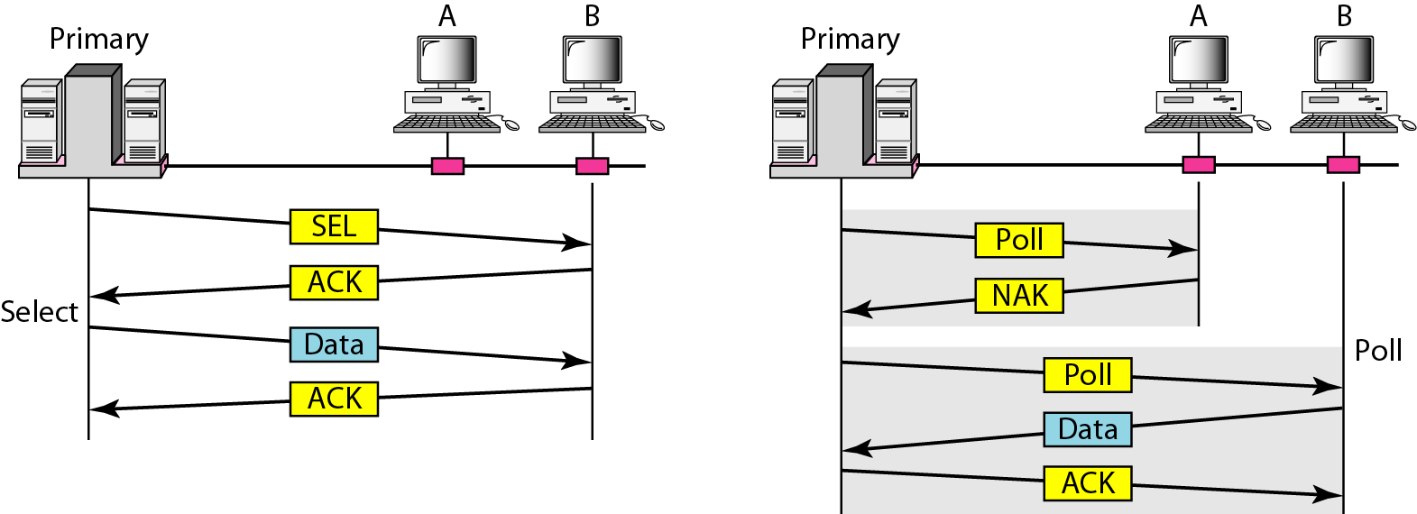
Select and poll functions in polling access method
Primary is sending to Secondary
Secondary is sending to Primary

Slide 74
Distributed polling
No primary and secondary
Stations have a known polling order list which is made based on some protocol
station with the highest priority will have the access right first, then it passes the access right to the next station (it will send a pulling message to the next station in the pulling list), which will passes the access right to the following next station,

Slide 75
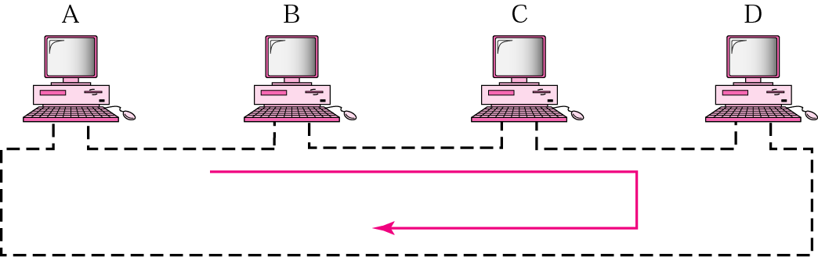
Token-Passing network
On a local area network, token passing is a channel access method where a signal called a token is passed between nodes to authorize that node to communicate
In contrast to polling access methods, there is no pre-defined "master" node
Implements Distributed Polling System

Slide 76
Token-Passing network
bits are copied to the output bits with a one bit delay
Bits are inserted by the station
listen mode
transmit mode
input
from
ring
1 bit delay
output
to
ring
delay
to station
from station
to station
from station
Station Interface is in two states:
Listen state: Listen to the arriving bits and check the destination address to see if it is its own address. If yes the frame is copied to the station otherwise it is passed through the output port to the next station.
Transmit state: station captures a special frame called free token and transmits its frames. Sending station is responsible for reinserting the free token into the ring medium and for removing the transmitted frame from the medium.

Slide 77
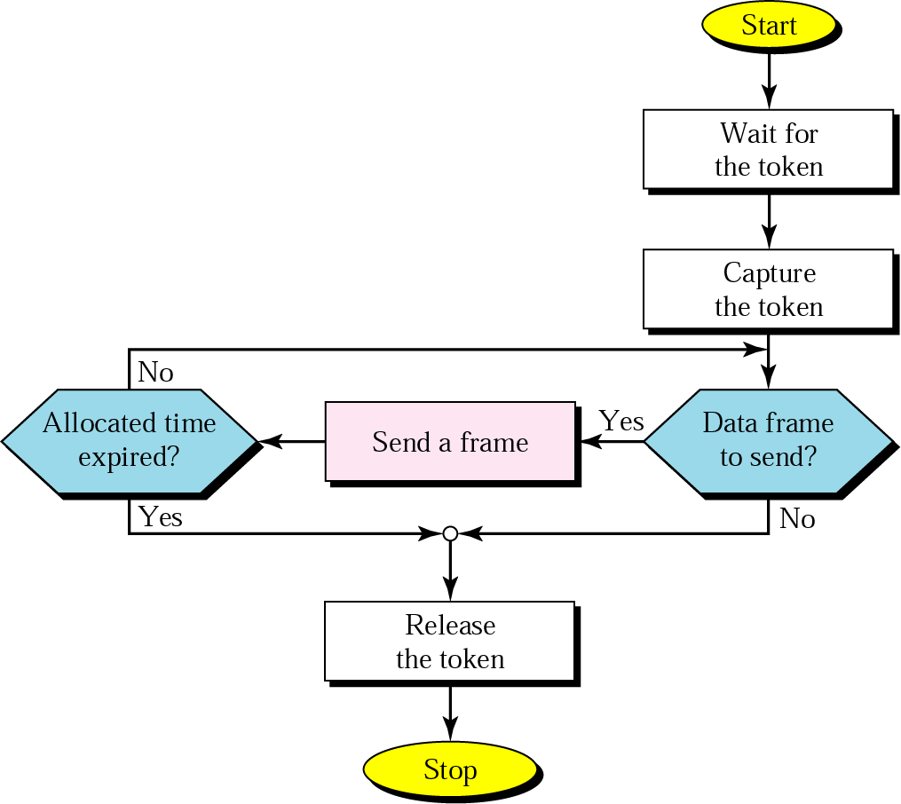
Token-passing procedure

Slide 78
Token Bus Frame Format
Preamble: 1 byte for synchronization.
Start Delimiter: 1 byte that marks the beginning of the frame.
Frame Control: 1 byte that specifies whether this is a data frame or control frame.
Destination Address: 2-6 bytes that specifies address of destination station.
Source Address: 2-6 bytes that specifies address of source station.
Payload: A variable length field that carries the data from the network layer.
Checksum: 4 bytes frame check sequence for error detection.
End Delimiter: 1 byte that marks the end of the frame.

Slide 79
Token Ring frame formats
Data or command frame
SD | AC | FC | DA | SA | PDU from LLC (IEEE 802.2) | CRC | ED | FS
8 bits | 8 bits | 8 bits | 48 bits | 48 bits | up to 18200x8 bits | 32 bits | 8 bits | 8 bits
Token
Abort frame
SD | AC | ED
8 bits | 8 bits | 8 bits
SD | ED
8 bits | 8 bits
SD: Starting delimiter J K 0J K 0 0 J, K are non data symbols, Line codes
AC: Access control PPPTMRRR P- Priority, T- Token bit, M- Monitor bit, R – Reservation bit
FC: Frame control FF ZZZ ZZZ FF – frame Type , Z – control bits
DA: Destination address
SA: Source address
PDU: data
CRC: check sum
ED: End delimiter JK1JK1 IE I Intermediate frame bit, E – Error detection bit
FS: Frame status A C xx AC xx , A Address recognized bit, C frame copied, xx undefined bit

Slide 80
CHANNELIZATION
Channelization is a multiple-access method in which the available bandwidth of a link is shared in time, frequency, or through code, between different stations.
Frequency-Division Multiple Access (FDMA)
Time-Division Multiple Access (TDMA)
Code-Division Multiple Access (CDMA)

Slide 81
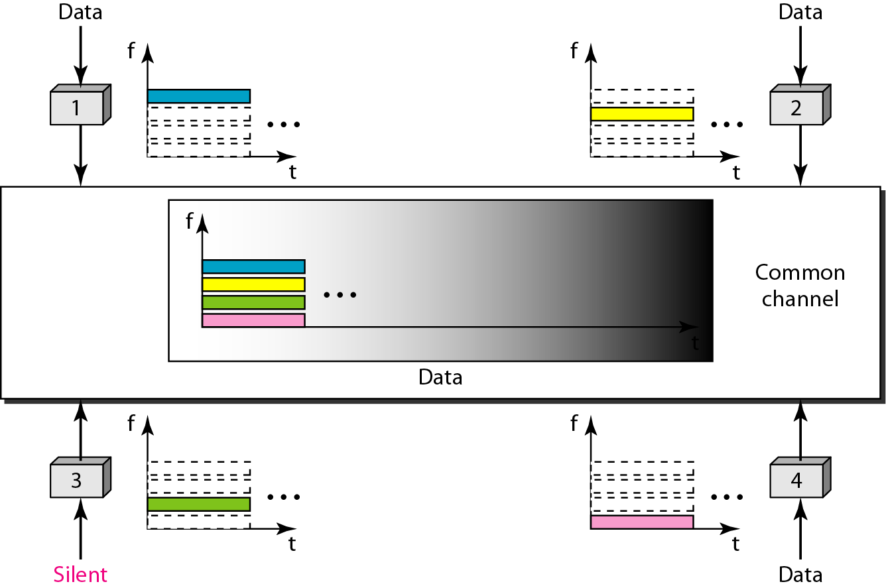
Frequency-division multiple access (FDMA)

Slide 82
CHANNELIZATION - FDMA
FDMA: Frequency Division Multiple Access:
Transmission medium is divided into M separate frequency bands
Each station transmits continuously on the assigned band at an average rate of R/M
A node is limited to an average rate equal R/M (where M is number of nodes) even when it is the only node with frame to be sent

Slide 83
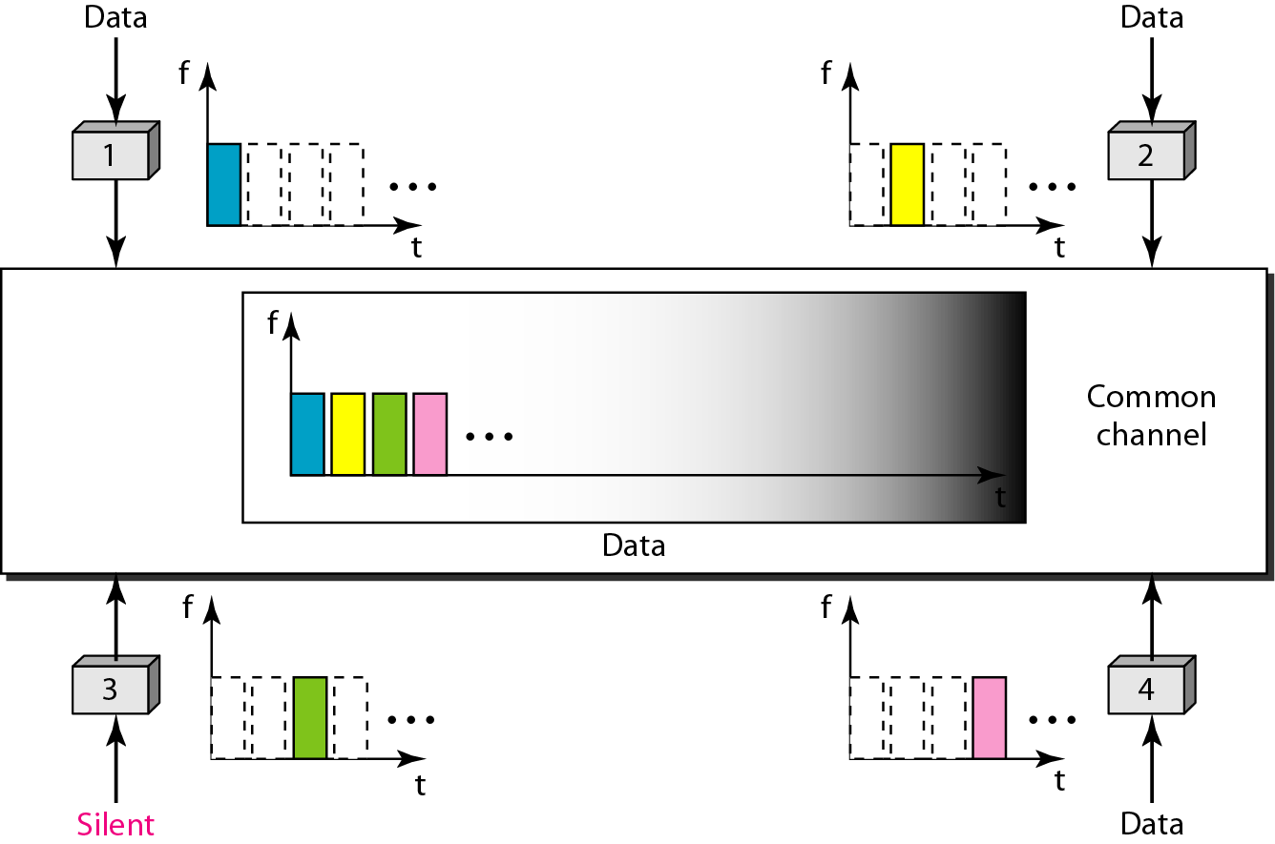
Time-division multiple access (TDMA)

Slide 84
CHANNELIZATION - TDMA
TDMA: Time Division Multiple Access
The entire bandwidth capacity is a single channel with its capacity shared in time between M stations
A node must always wait for its turn until its slot time arrives even when it is the only node with frames to send
A node is limited to an average rate equal R/M (where M is number of nodes) even when it is the only node with frame to be sent

Slide 85
CHANNELIZATION - CDMA
CDMA: Code Division Multiple Access
In CDMA, one channel carries all transmissions simultaneously
Each station codes its data signal by a specific codes before transmission
The stations’ receivers use these codes to recover the data for the desired station

Slide 86
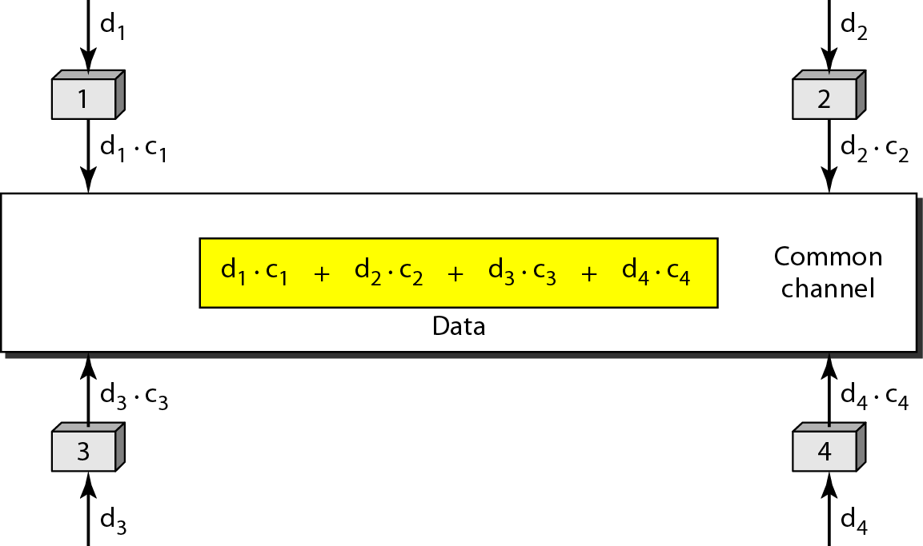
Simple idea of communication with code

